Slide 1
What is D3?
1,000 Foot View

Slide 2
D3 is an open source JavaScript framework
Similar to jQuery
But allows “data-binding,” a (or perhaps the) key component of D3
Data binding allows you to bind data to DOM elements, like <p> tags.

Slide 3
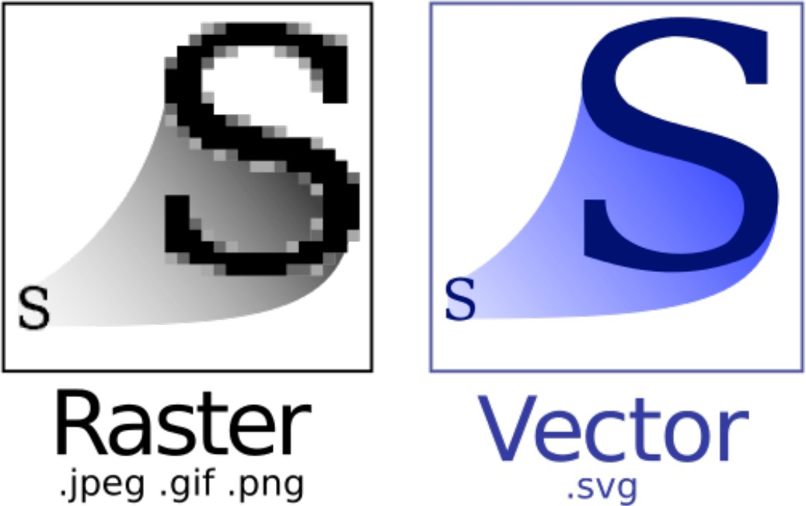
D3 can use SVG (scalable vector graphics)
Raster < Vector
SVG’s consist of DOM elements

Slide 4



Slide 5
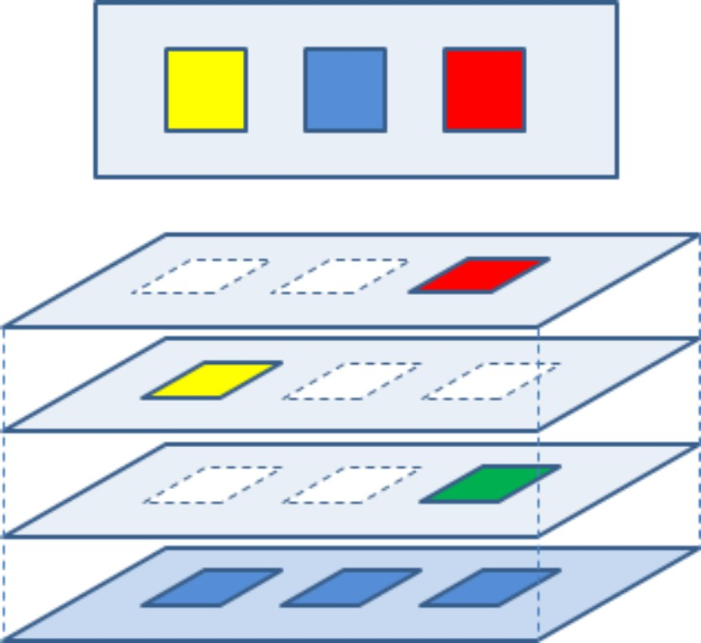
SVG works with layers over layers
Sometimes what you’re looking for is there, just underneath something else.

Slide 6
Say it again?
D3 is a JavaScript framework for building data visualizations
D3 binds data to DOM elements on an SVG, which acts like your canvas

Slide 7
The Building Blocks of a D3 Visualization

Slide 8
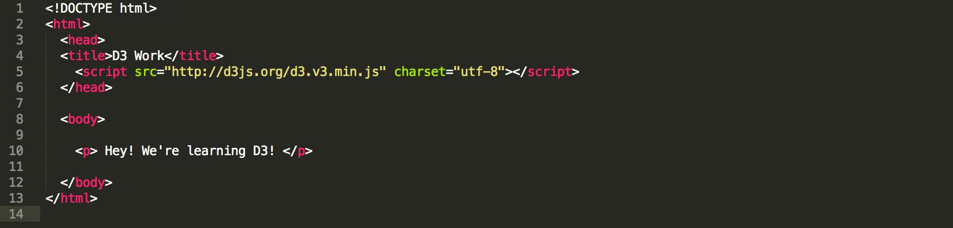
HTML
HyperText Markup Language
The initial setup for your D3 visualization
Provides the structure that you work in

Slide 9
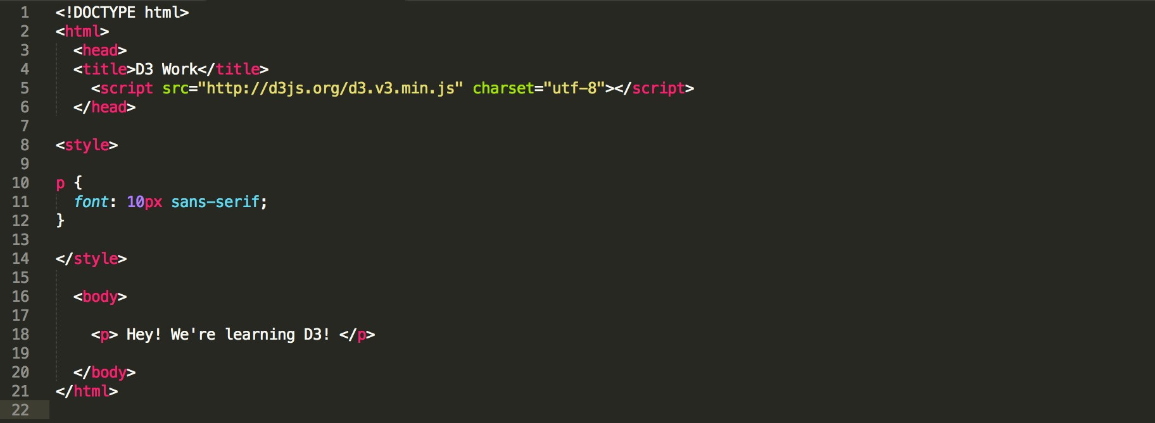
CSS
Cascading Style Sheets
The look of your D3 visualization
Maps visual attributes to HTML objects

Slide 10
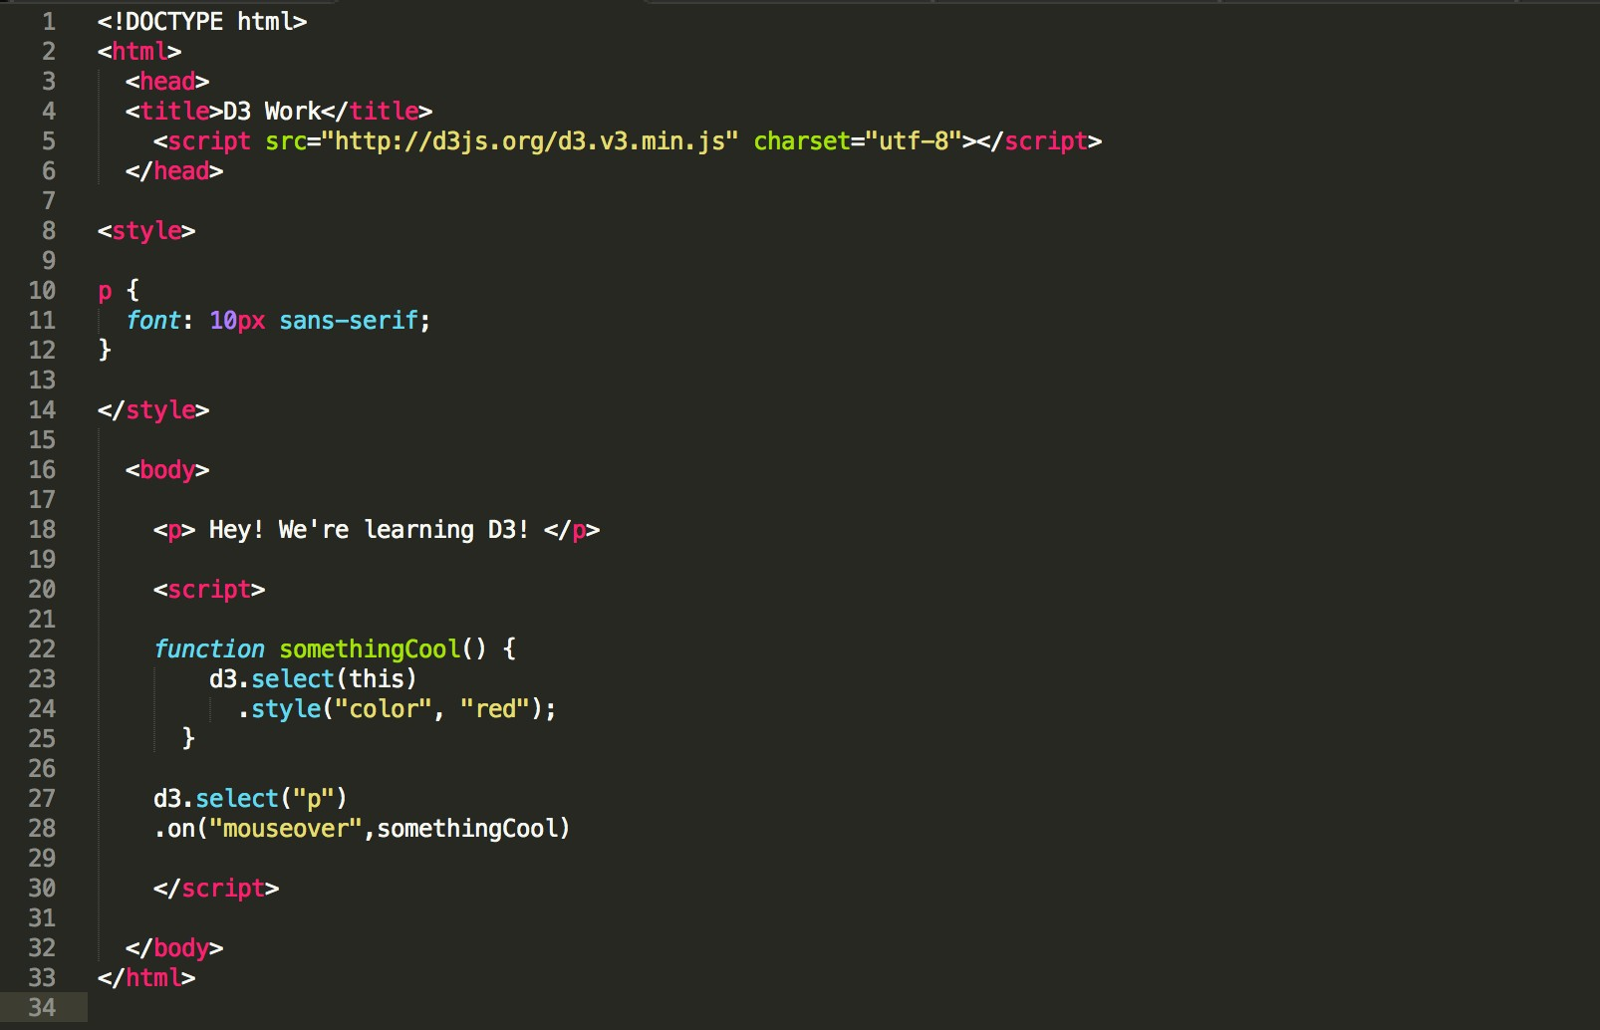
JavaScript
JavaScript then says how your visualization works

